Slide 1
Group 1
Bouhadan Imad, Dellafaille Lander, Mariën Levi, Pepermans Manu, Van de Mieroop Kevin

Slide 2

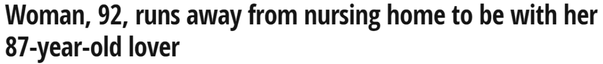

Introduction
Eldertrack
What is ElderTrack?
What can ElderTrack do for you?
Is ElderTrack worth buying?

Slide 3
Introduction
Eldertrack
Indoor localization (floor and room)
Outdoor localization (coördinates)
Cloud based monitoring platform

Slide 4
Buildup of the project
Outdoor
LoRaWAN
data
Back-end
DASH7
RSSI + DATA
Indoor
GPS
Parsing
Barometer
ThingsBoard.io
Temperatuur
Fingerprinting
e-Compass

Slide 5
Backend
Parsing
Subscribed to 3 MQTT topics:
/tb: Dash7 data
/loriot: LoRa data
/localisation: RSSI values for kNN
Publishing to ThingsBoard.io with ThingsBoard API and MQTT
Remote procedure call with ThingsBoard API

Slide 6
Backend
Parsing
Dash7 data is parsed through checking the first value:
“M”agnetometer information:
0-360 degrees -> changed to cardinal direction
“B”arometer information:
raw values from sensor -> changed to altitude
“O”K message
Dash7 RPC is received by node
“E”rror message
LoRaWAN is not joined on node
LoRa data is parsed through checking if GPS information is valid:
“A”ctive, GPS data is valid
change minutes to degrees and correct if GPS data is from Southern Hemisphere
kNN is calculated if RSSI values are received within one second form at least 3 gateways

Slide 7
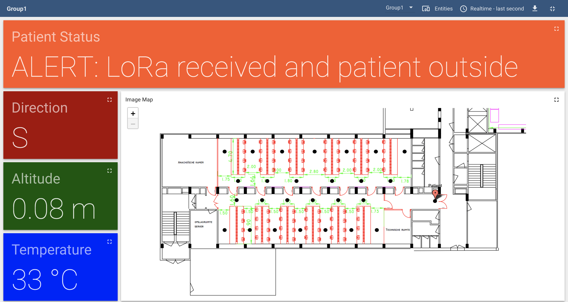
Backend
Thingsboard.IO

Slide 8
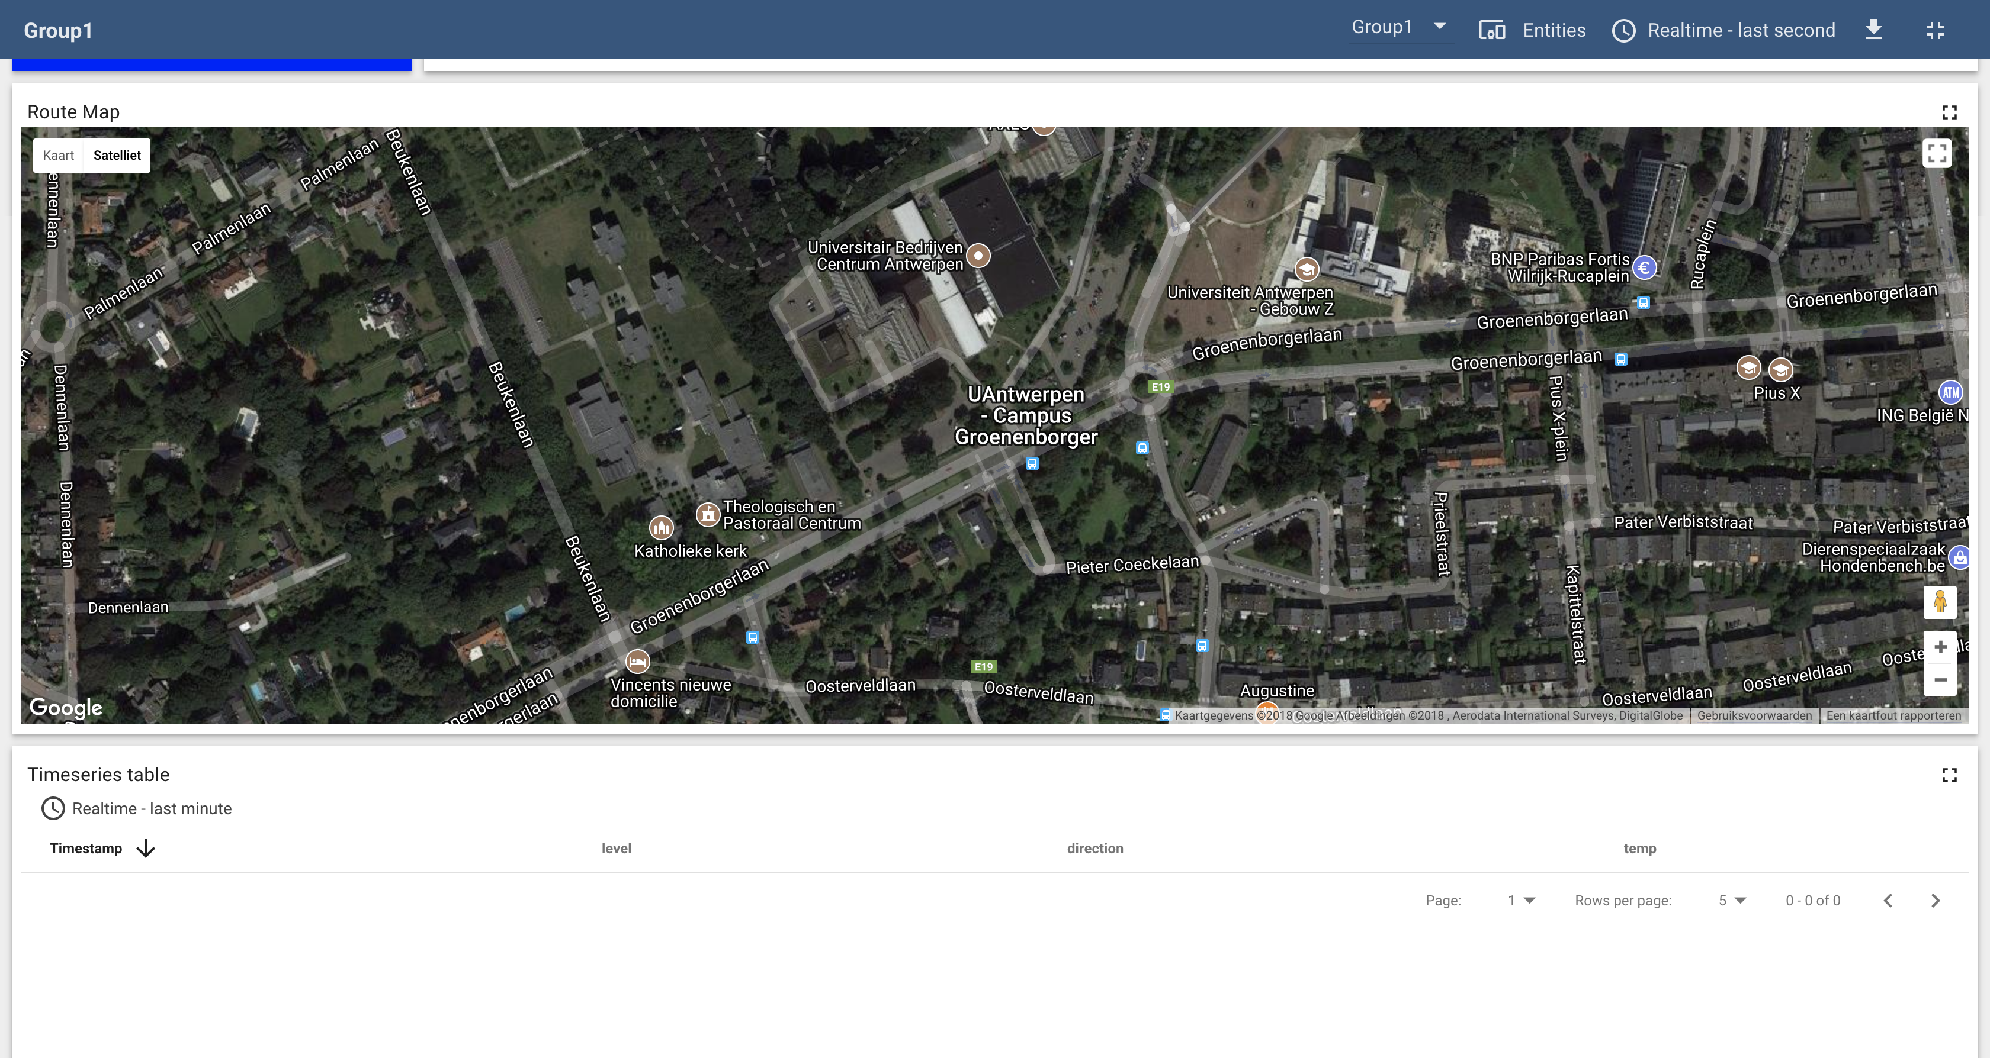
Backend
Thingsboard.IO

Slide 9
Fingerprinting
KNN-Algorithm & Database
Receive Data
Calculate Distances
Find Neighbor
Vote on labels
2.2
2
2.4
1
3.1
1
3.5
Natasha Latysheva (2016). Implementing Your Own kNN using Python. https://www.kdnuggets.com/2016/01/implementing-your-own-knn-using-python.html

Slide 10
Frontend
Back-end
Frontend
Parsing
Temperature
DASH7 (Data + RSSI)
Barometer
ThingsBoard.io
e-Compass
Control
Fingerprinting
LoRaWAN (DATA)
GPS

Slide 11
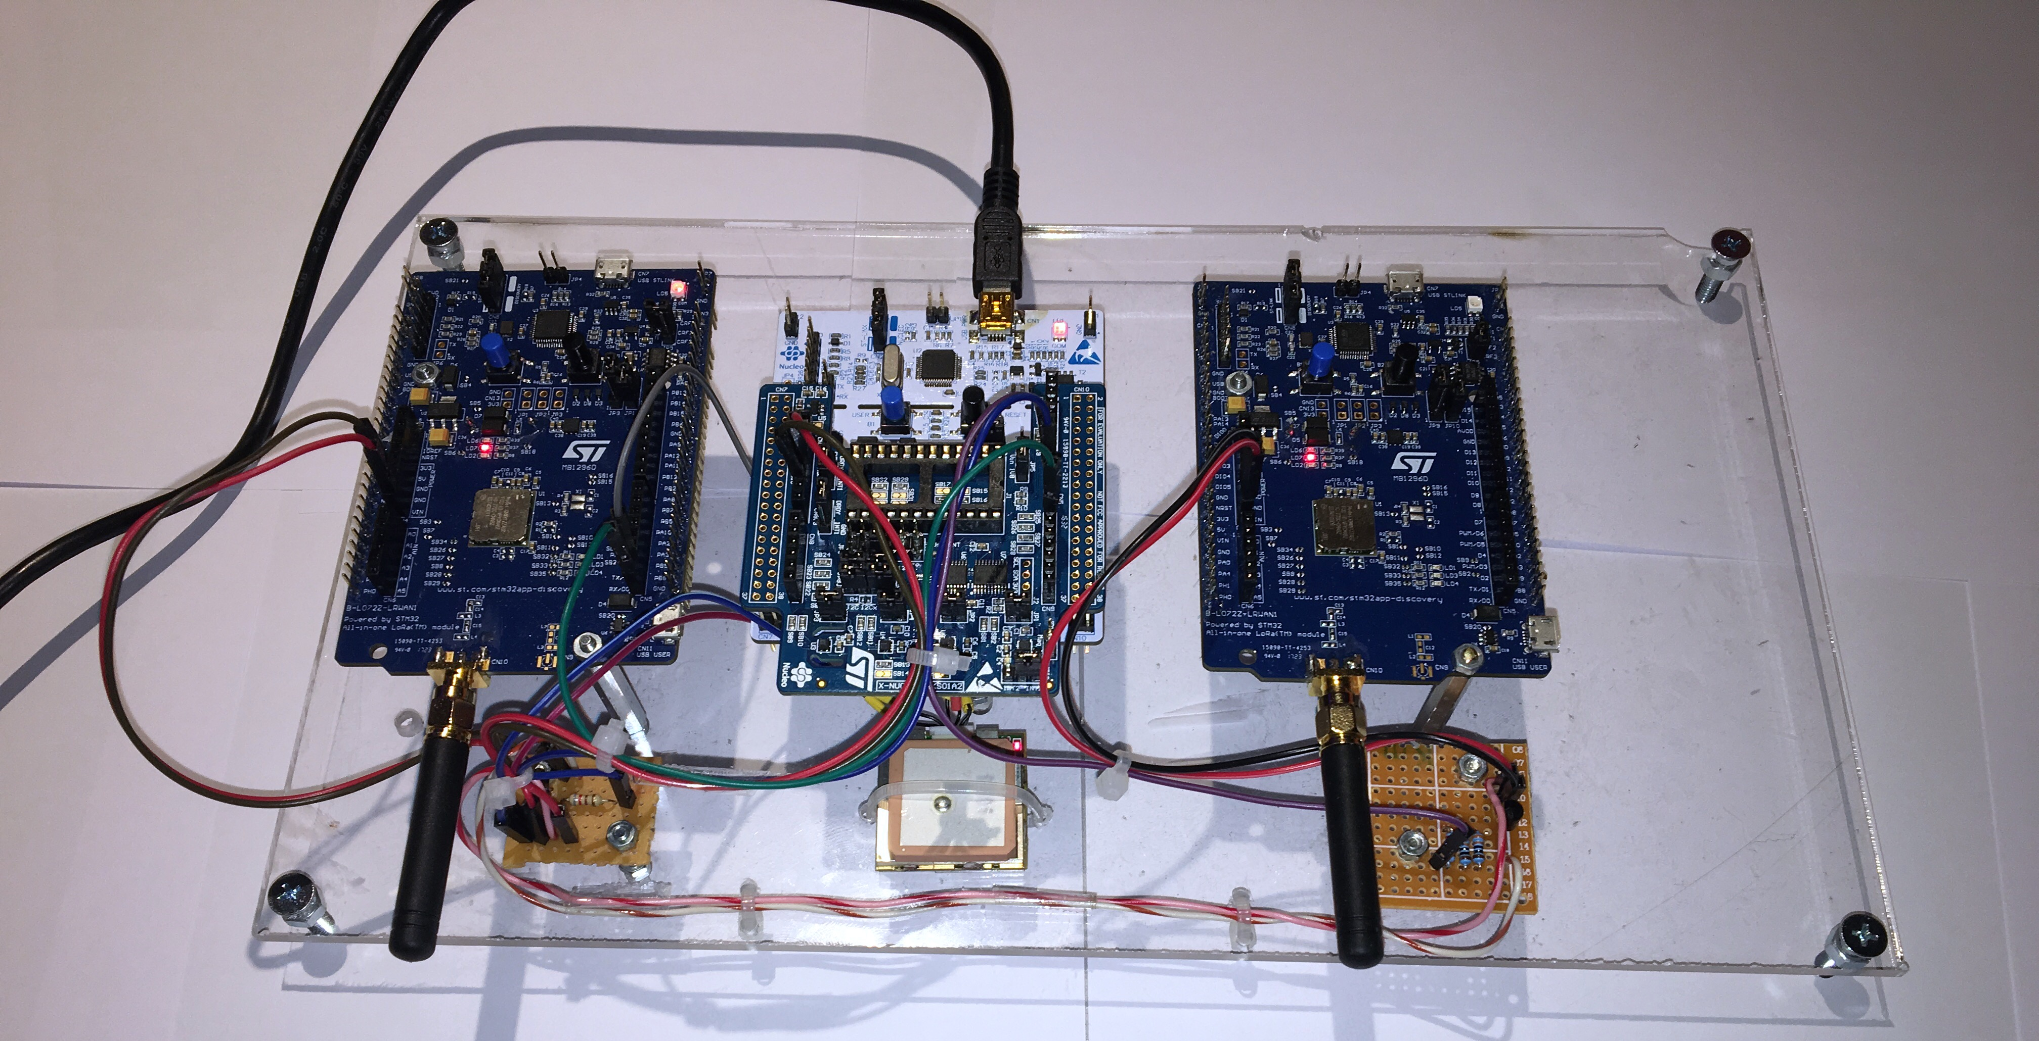
HARDWARE

Slide 12
Communication (OUTDOORs)
LoRAWAN
B-L072Z-LRWAN1
Only activated when entering danger zone
GPS Data to gateway
AT Commands
ATZ
AT+JOIN
AT+JNS=?
AT+SEND when data comes in

Slide 13
GPS (OUTDOORS)
NMEA commands
GPGLL : Latitude, N/S, Longtitude, E/W, Time, Data valid
Initializing
AT+SEND:2=“5117.1421,N,0000428.4897,E,230746.000,A,A*56”
Optimizing: Hot start

Slide 14
Communication (INDOOR )
DASH7
Uplink: Sensordata + RSSI
Barometer and Temperature sensor
kNN
Downlink: Alarm when tracked person is outside
Listen for command
ALP Command

Slide 15
SENSOR (INDOOR)
Barometer & temperature
Imad

Slide 16
Control Unit
Finite State Machine (FSM)
DIAGRAM

Slide 17
SENSOR Outdoor
Ecompass
Levi

Slide 18
Implementation
Drivers
Levi

Slide 19
Documentation
Levi

Slide 20
Energy consumption
Low power features
Levi

Slide 21
Energy consumption
Estimation by CubeMX
Levi

Slide 22
Energy Consumption
Measured Energy consumption
Levi

Slide 23

Demonstration

